Slide 1

ATTENDANCE TRACKER UI
RNS INSTITUTE OF TECHNOLOGY
BENGALURU - 98
DEPARTMENT OF INFORMATION SCIENCE & ENGINEERING
Presentation on Internship
Kayak V Gornale
USN: 1RN18IS060
ENMAZ Engineering Services Pvt. Ltd.
Internal Guide
Mr. T S Bhagavath Singh
Associate Prof, Dept of ISE, RNSIT
External Guide
Mr. Akshay D R
Co-Founder & CEO, Enmaz Engineering Services Pvt. Ltd., Bangalore

Slide 2
AGENDA
Abstract
About the Company
Introduction
Requirements
System Design
Implementation
Results
Testing
Conclusion and Future Enhancements
References
Q & A

Slide 3
ABSTRACT
Student attendance management system deals with the maintenance of the student’s attendance details.
It generates attendance of the student on the basis of presence in class. Each student is given a username and password.
The student can log in into his/her account and check their attendance.

Slide 4
About the Company
Enmaz Engineering Pvt. Ltd is a Service based company founded in the year 2019.
It specializes in
Embedded H/W Development
Embedded Firmware Development
Cloud support
Big Data Analysis and Reporting
Dashboard UX/UI design and development
Model Analysis.

Slide 5
INTRODUCTION
Attendance Tracker UI is a system which allows students to keep track of their attendance without any hassle.
Students can get their attendance details across all the subjects in one app.
It also calculates the attendance percentage based on the number of classes attended by the student and total number of classes conducted.

Slide 6
Literature Survey
Effective and Efficient Attendance Tracking System Using Secret Code: By Teh Jian Zhi, Zailani Ibrahim and Hazleen Aris, from College of Information Technology University Tenaga Nasional Kajang, Selangor
Attendance Management System: By Dayanand G Savakar from Rani Chennamma University, Belagavi, Karnataka, India, and Ravi Hosur from BLDEA’s Vachana Pitamaha Dr. P.G.Halaktti College of Engg. & Tech, Bijapur, India

Slide 7
Requirements
Hardware Requirements
CPU: Pentium processor and above
RAM: 4 GB
HDD: 40 GB
Software Requirements
Operating System: Windows 8 and above
Editor: Visual Studio Code
IDE: VS Code
Front-end Language: Dart
Minimum Android Version : Froyo (API Level 8)

Slide 8
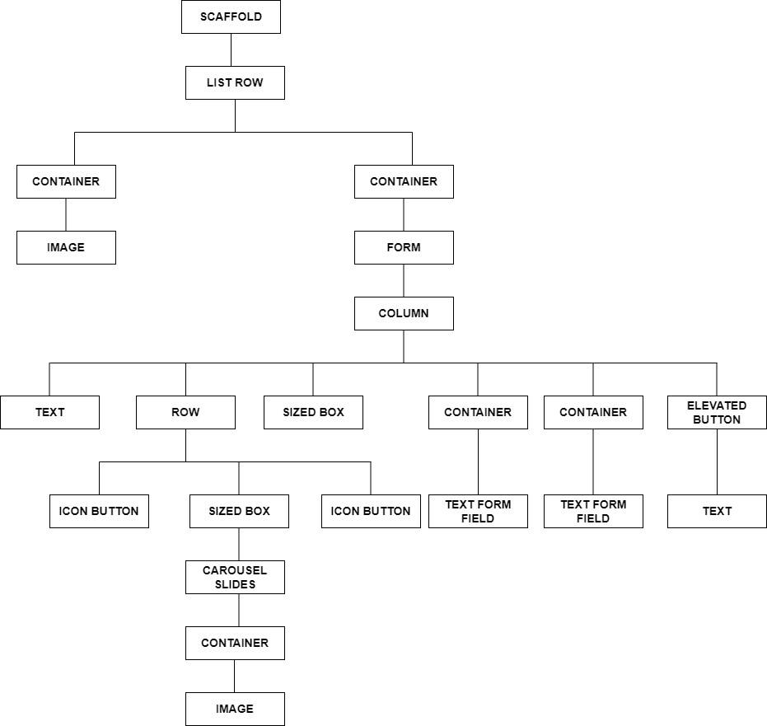
System Design
Widget Tree for Login Screen

Slide 9
Implementation / Coding
import 'package:flutter/material.dart’;
import 'package:rnsit_college_app/screens/login.dart';
void main() {
runApp(const MyApp());
}class MyApp extends StatelessWidget {
const MyApp({Key? key}) : super(key: key);
@override
Widget build(BuildContext context) {
return const MaterialApp(
title: "RNS Institute of Technology",
themeMode: ThemeMode.light,
debugShowCheckedModeBanner: false,
home: LaunchScreen()); }}

Slide 10
Implementation/Coding
class LaunchScreen extends StatefulWidget {
const LaunchScreen({Key? key}) : super(key: key);
@override
_LaunchScreenState createState() => _LaunchScreenState();
}
class _LaunchScreenState extends State<LaunchScreen> {
@override
Widget build(BuildContext context) {
return Login();
}
}

Slide 11
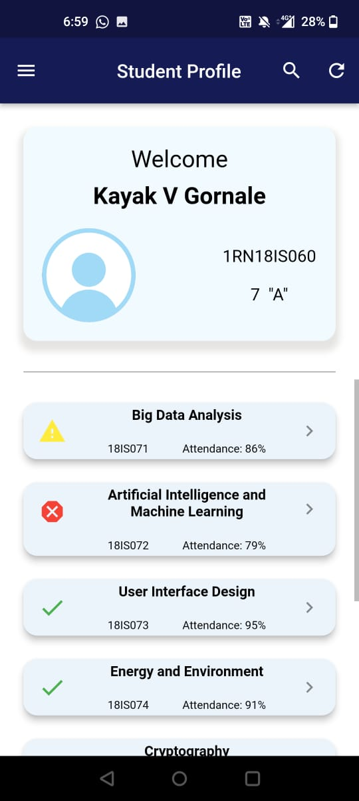
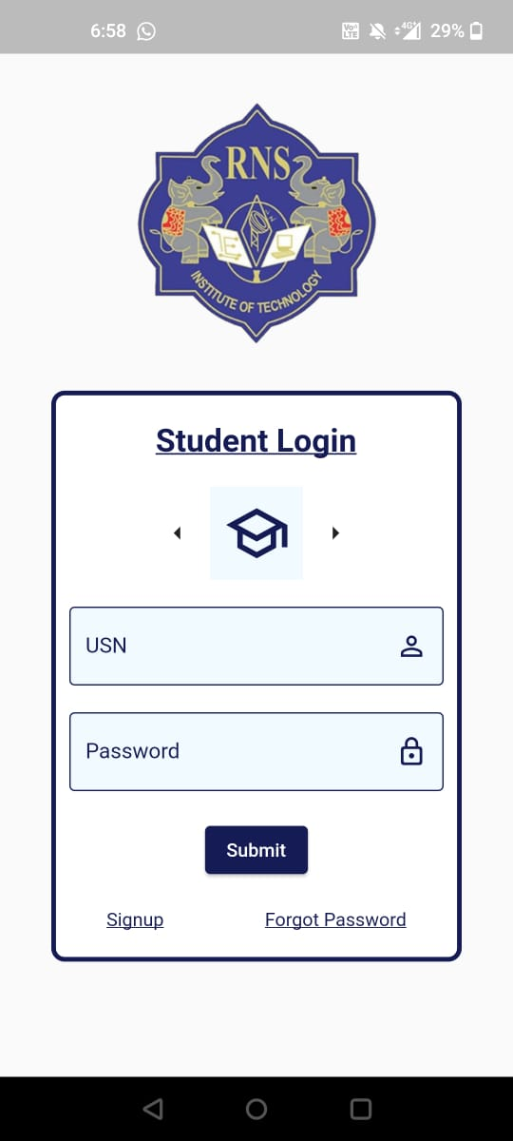
Results
Login Screen
Attendance Details Screen

Slide 12
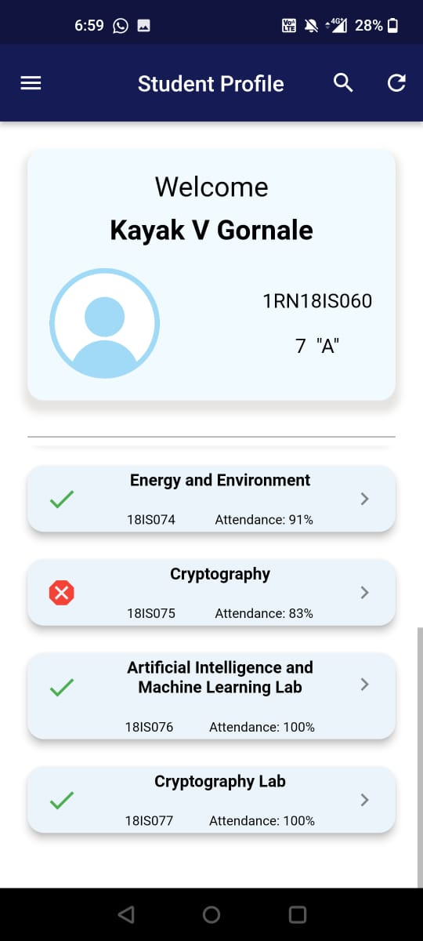
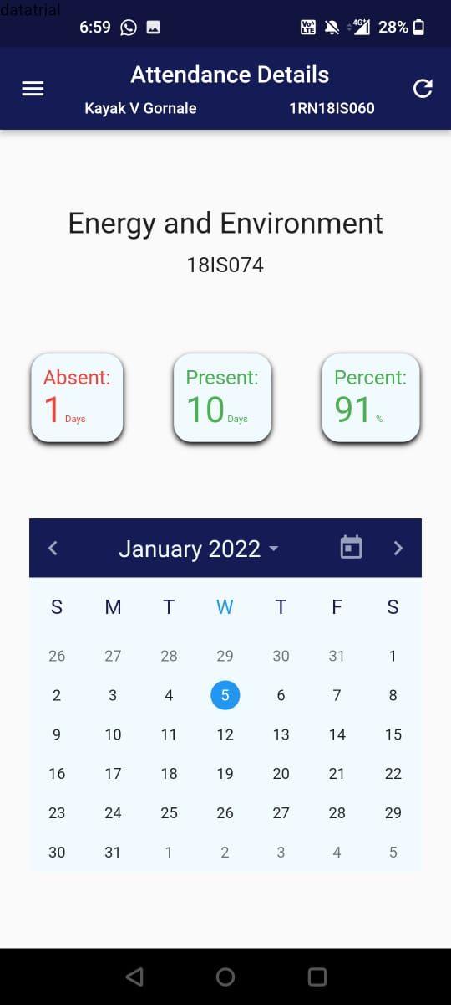
Results
Attendance Details screens
Subject wise details

Slide 13
Testing
Testing is a process of executing a program with the interest of finding an error. Levels Of Testing
Unit Testing
Integration Testing
Validation Testing
Output Testing
User Acceptance Testing

Slide 14
CONCLUSIONS
• This application is beneficial for teachers as well as students.
• Reduces human effort that is required.
• Since this a basic application it has a greater scope to add more features as required

Slide 15
Future Enhancements
A separate set of screens can be developed for teachers so that they can easily keep track of the attendance of all the students of a particular class.
A detailed record of the days when the student was absent can be included.
An option for the teachers to generate report can be included.

Slide 16
REFERENCES
[1] https://flutter.dev/
[2] https://developers.google.com/learn/pathways/intro-to-flutter
[3] Beginning Flutter: A Hands On Guide to App Development by Marco L
Napoli
[4] https://stackoverflow.com/

Slide 17
Question and Answer

Slide 18
THANK YOU

